Slide 1
An Investigation into the Smart Watch Interface and the User Driven Data Requirements for its Applications
Seminar 1
Project Outline and Research Goals
Principal Investigator:
Kyle Johnson
Project Supervisors:
Prof. Hannah Thinyane
Mrs. Ingrid Siebörger

Slide 2
Problem Overview
Smart watches, can they be a successful alternative interface to established mobile interfaces for human-computer interaction?
Can user data needs be met by such an interface if they chose to use it instead of established mobile interfaces?
Assess the user preference between data access on current mobile platforms and the smart watch interface.

Slide 3
Problem Overview
Previous smart watches did not fully utilise open source solutions. Their manufacturers determined the applications to be used on their devices.
Standardization of API’s for such devices and the dominance of Android enables new possibilities for user driven data needs. (More dynamic environment for application deployment)

Slide 4
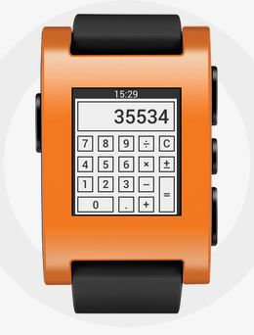
Pebble smart watch
Used for this study
Simplicity
Minimalistic e-paper display
Not a stand-alone device, must be
paired with a host smart phone via
Bluetooth.
Acts as a peripheral to that device,
all data gets processed on the
paired smart phone.
(Differs from Samsung Galaxy Gear + Gear 2)

Slide 5
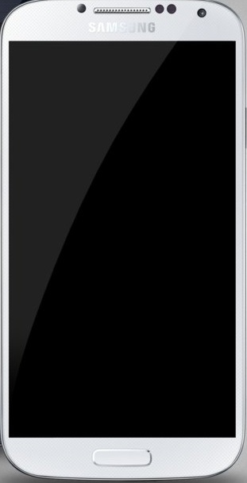
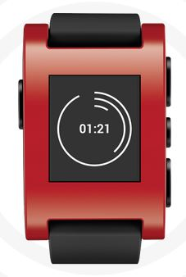
Paired Pebble smart watch

Slide 6
Research
Data needs of university students for the Pebble smart watch, this will be the user sample.
Information acquired from the users via a survey:
Would they want a Pebble to access data?
What data would they access on it?
Develop applications for Android based on above through the use of PebbleKit SDK.

Slide 7
Research
Allow users to test the applications once developed (Do they satisfy their requirements?).
Comparisons to be made between the smart watch interface and the existing smart phone interface in terms of data access (Similar applications on smart phones?).

Slide 8
Aims
Will users select a smart watch over a smart phone interface? Perhaps in certain situations? (Migration from using only the smart phone interface)
Survey: Demographics of users ? Male or female? age?
Multi-functionality (smart phone) vs. Convenience (smart watch).
Can the smart watch interface provide a convenient display interface while still satisfying user data requirements?

Slide 9
Questions?

